Slide 1
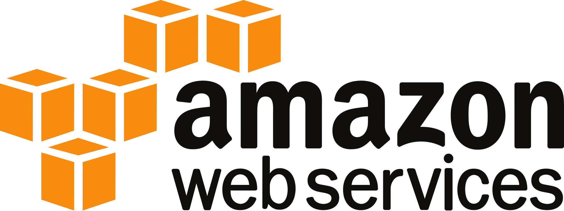
Infrastructure as Code:
JANUARY 10, 2018
No. 28

Slide 2

Welcome!
About Us: Learning how to create full-stack, scalable internet applications. From the database… all the way to the front-end user interface : JavaScript Frameworks ∙ Server-Side Code ∙ Load Balancing
Meetup Calendar:
https://www.meetup.com/SaintLouis_FullStack_WebDevelopment/events/
Slack Group(s):
https://stl-tech.slack.com/messages/stl_fullstack_web_dev/

Slide 3


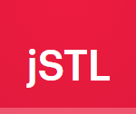

What Others Are Doing….
“Crash Course – Learn JavaScript!”
Jan 11 (Thu) • 6:30 pm
4818 Washington Blvd, 1st Floor • St. Louis, MO
“#4 Echo Buttons, Alexa for Business & More!”
Jan 17 (Wed) • 5:30 pm
Location TBD • TBD
The Vue.js Ecosystem
Jan 24 (Wed) • 7:00 pm
CIC@CET • 20 S. Sarah St
Topic TBD
Feb 8 (Tue) • 6:00 pm
CIC@CET • 20 S. Sarah St

Slide 4
“Old World” Problems
FOR I.T. Infrastructure….
LARGE and Upfront Costs
LOOOOONG Install Times
HIGH Maintenance

Slide 5
Solution
CLOUD COMPUTING!!
Capital Expenditures → Operational Expenses
More Pricing Flexibility …. More Control
On-Demand I.T. Infrastructure
Shorter Procurement Cycle
Minimal (Zero?) Maintenance
Software Maintenance Only

Slide 6
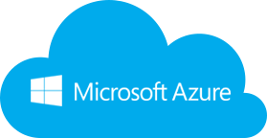
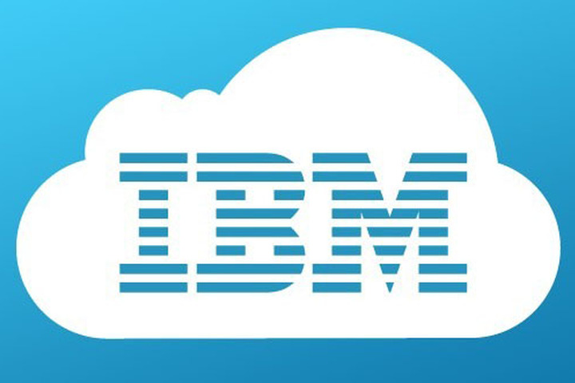
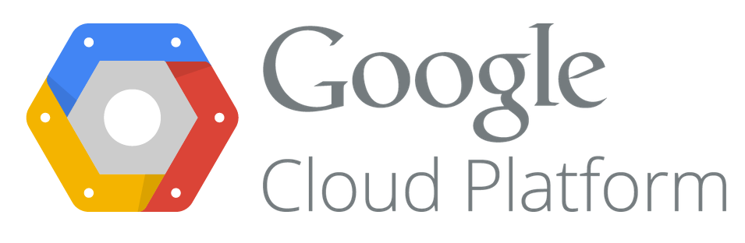
What Is Amazon Web Services?
AWS – The Largest Cloud Provider
Computing resources for rent
Est. 2006 (or 2004)
Simple Storage Service (S3)
Simple Queue Service (SQS)
IaaS …. PaaS …. SaaS Offerings
Bare-Metal (e.g. EC2)
Managed (e.g. RDS)
End Applications (e.g. WorkMail)

Slide 7
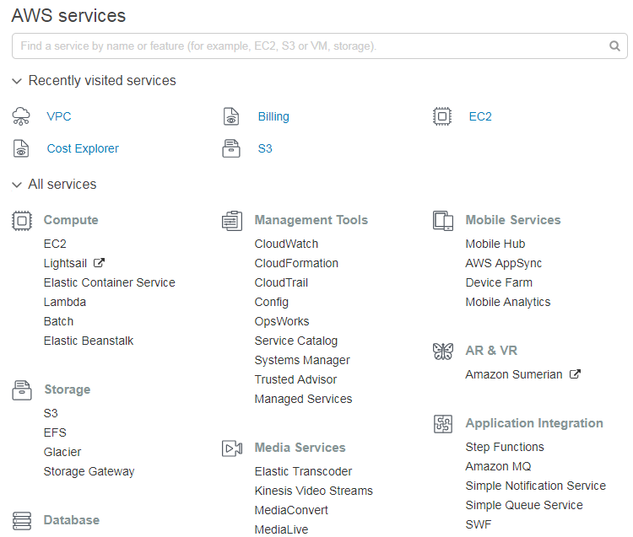
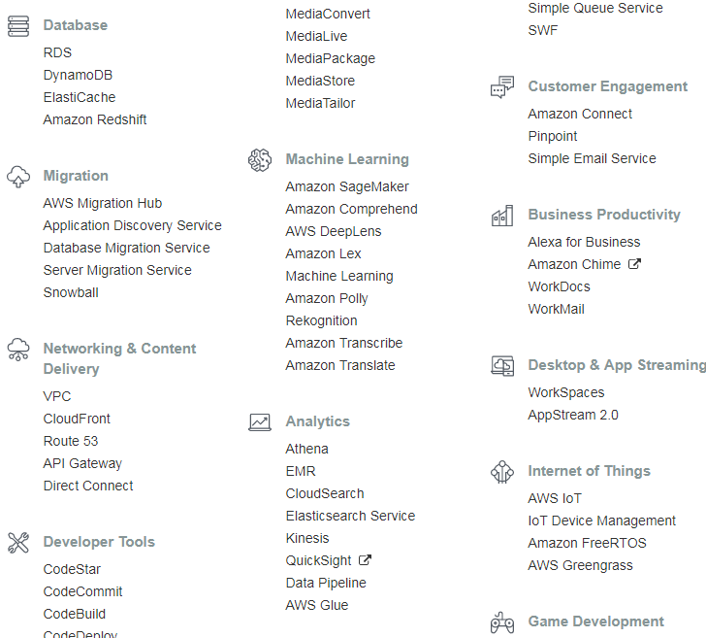
How AWS Fits in the Full Stack…
Many, Many Services….

Slide 8
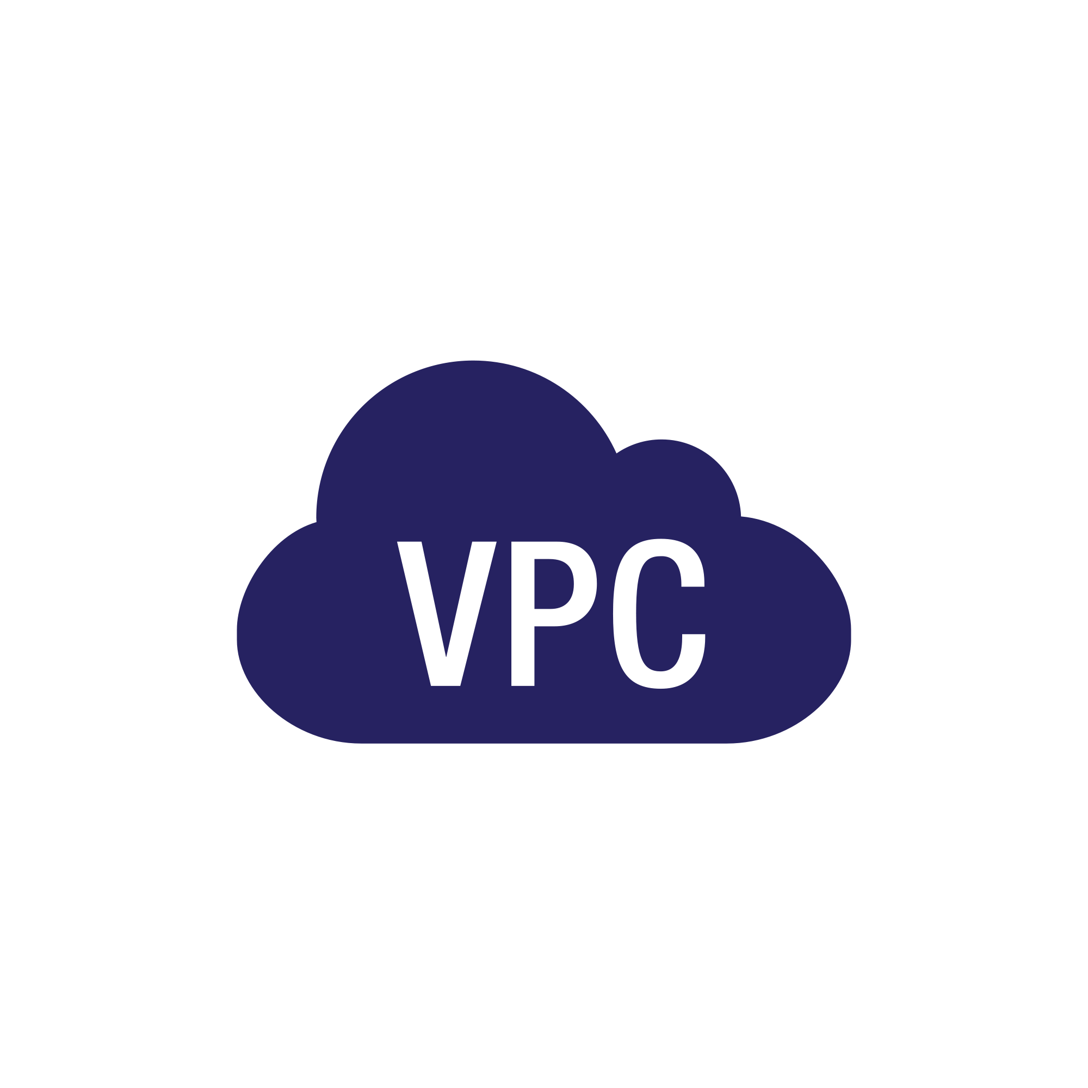
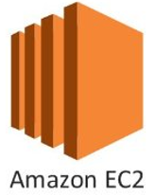
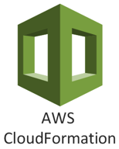

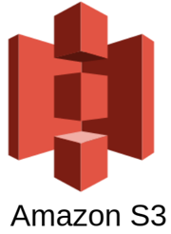


Key AWS Components
Compute Resources
Virtual Server
Isolated Section of AWS Cloud
Block Storage
Databases
Coded Infrastructure for AWS Components
Object Storage
Images…. Files…. Other
Managed Relational Databases (e.g. PaaS)

Slide 9
Interacting with AWS
Console
Point-and-Click…. GUI
CLI
Command-Line Invocations
AWS SDK
Multi-Language Support (e.g. Python, PHP, Java, Node,….)

Slide 10
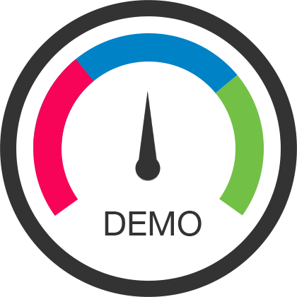
To The Terminal!
1. Create an EC2 (via AWS console)

Slide 11
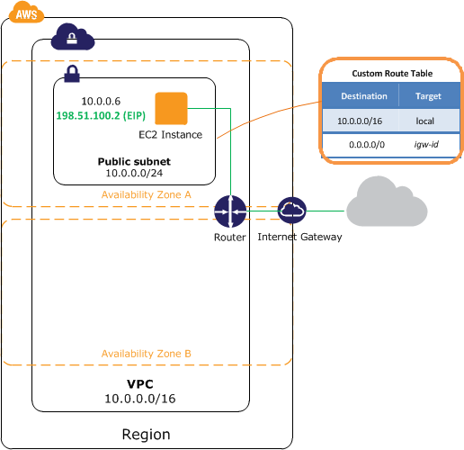
VPC Concepts (Networking)

Slide 12
VPC Concepts (Networking)
Region
Geographic zones for the AWS cloud (e.g. US-East…. Canada…. Singapore)

Slide 13
VPC Concepts (Networking)
Region
Geographic zones for the AWS cloud (e.g. US-East…. Canada…. Singapore)
Availability Zone
Physical data centers within a region…. Multiple AZ’s for High Availability

Slide 14
VPC Concepts (Networking)
Region
Geographic zones for the AWS cloud (e.g. US-East…. Canada…. Singapore)
Availability Zone
Physical data centers within a region…. Multiple AZ’s for High Availability
Virtual Private Cloud
Isolated virtual network in AWS for your use…. Per Region….
Collection of IP Addresses

Slide 15
VPC Concepts (Networking)
Region
Geographic zones for the AWS cloud (e.g. US-East…. Canada…. Singapore)
Subnet
Range of IP Addresses in your VPC….
(a) Public vs. (b) Private
Availability Zone
Physical data centers within a region…. Multiple AZ’s for High Availability
Virtual Private Cloud
Isolated virtual network in AWS for your use…. Per Region….
Collection of IP Addresses

Slide 16
VPC Concepts (Networking)
Region
Geographic zones for the AWS cloud (e.g. US-East…. Canada…. Singapore)
Subnet
Range of IP Addresses in your VPC….
(a) Public vs. (b) Private
Availability Zone
Physical data centers within a region…. Multiple AZ’s for High Availability
Internet Gateway
Provides direct connectivity to the Internet…. Needed for public subnets
Virtual Private Cloud
Isolated virtual network in AWS for your use…. Per Region….
Collection of IP Addresses

Slide 17
VPC Concepts (Networking)
Region
Geographic zones for the AWS cloud (e.g. US-East…. Canada…. Singapore)
Subnet
Range of IP Addresses in your VPC….
(a) Public vs. (b) Private
Availability Zone
Physical data centers within a region…. Multiple AZ’s for High Availability
Internet Gateway
Provides direct connectivity to the Internet…. Needed for public subnets
Virtual Private Cloud
Isolated virtual network in AWS for your use…. Per Region….
Collection of IP Addresses
Router & Route Table
Routes traffic to/from the VPC
Router → Roads (w/ IGW)
Route Table → Directions

Slide 18
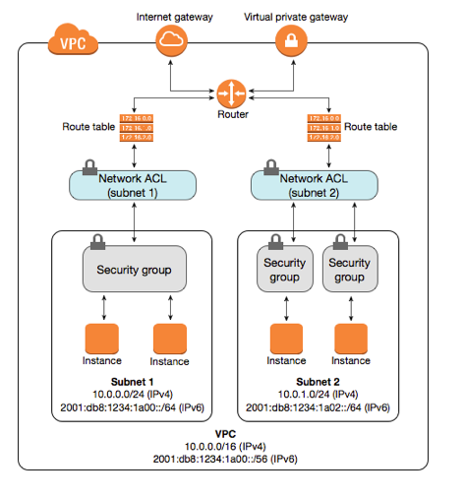


VPC Concepts (Layered Security)
Router & Route Table
Routes traffic to/from the VPC
Roads and Directions
At the Subnet Level
Default Route Table per VPC

Slide 19
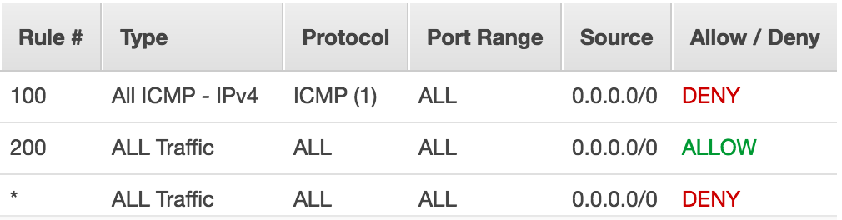
VPC Concepts (Layered Security)
Network ACL
Controls Traffic in/out of Subnets
Manage Traffic Flow
- explicit ALLOW
- explicit DENY
Rules comprise:
- Protocol
- Port
- IP Address
Rules evaluated in # order UNTIL the first match
Stateless

Slide 20
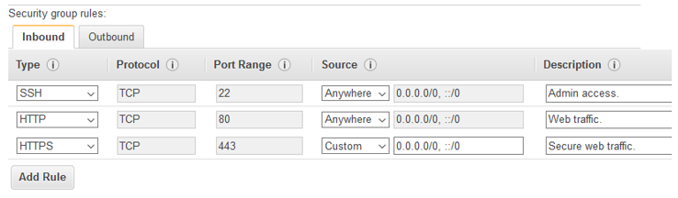
VPC Concepts (Layered Security)
Security Group
Every instance needs one
Up to 5 (per network interface)
Manage Traffic Flow
- explicit ALLOW
- implicit DENY
- Inbound and Outbound
Rules comprise:
- Protocol
- Port
- Source and Destination
All Rules get evaluated
Stateful
Dynamic

Slide 21
To The Terminal!
2. VPC (via AWS console) …. Create a few VPC components

Slide 22
CloudFormation Concepts
Programmable Infrastructure
Infrastructure as Source Code!
Version Control…. Unit Testing (?)
Less Errors…. Less Tedium
Change Sets
Method of updating a CloudFormation Stack
You can preview the changes
Templates
Describes your resources and properties
The actual source code
JSON or YAML
Data format options for CloudFormation templates
YAML→ Readable….. Comments
Stacks
Collection of AWS resources managed as a single unit

Slide 23
CloudFormation Template
Format Version
AWS CloudFormation template version that the template conforms to (Only one version so far)
Parameters
Values you can pass into your template at runtime
Resources ** REQUIRED **
Stack resources and their properties (e.g. EC2’s…. S3 buckets…. Subnet…. Route Table)
Description
Describes the template…. If used, must follow the Format Version section
Conditionals
Scenarios that determine if resources are created or certain properties are assigned (e.g. Production Stack vs. Testing Stack)
Metadata
Additional information about the template
Mappings
Key-Value lookup table for conditional values to use within the template
(e.g. For dynamic AMI lookups by region)
Outputs
Values returned by your stack…. Can be used to facilitate Cross-Stack References

Slide 24
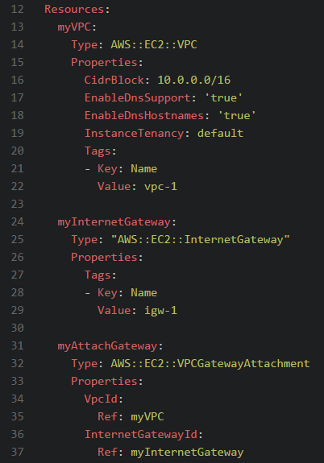
CloudFormation Template – Resources
Template Section
Denotes the beginning of one of the eight CloudFormation sections (e.g. Metadata; Outputs)
AWS Type
Determines the functionality of a resources
Must be a valid AWS Type
Properties
Based on the AWS Type
Not all properties are required
Identifier
Unique ID within a template (or chain of templates)
Reference this ID throughout the template
Tags
Custom Key-Value pairs for further processing or informational purposes

Slide 25
CloudFormation Template – Enhancers
Ref
Refer to another template component via its Identifier
Fn::FindInMap
Returns value from the relevant key in a two-level map
Fn::If
Returns first value if true…. Second value if false
Fn::ExportValue
Outputs a value for consumption by downstream stack
Fn::Sub
Substitutes variables in an input string w/ values you specify
Fn::ImportValue
Returns the value of an output exported by a previous stack
CROSS-STACK REFERENCE

Slide 26
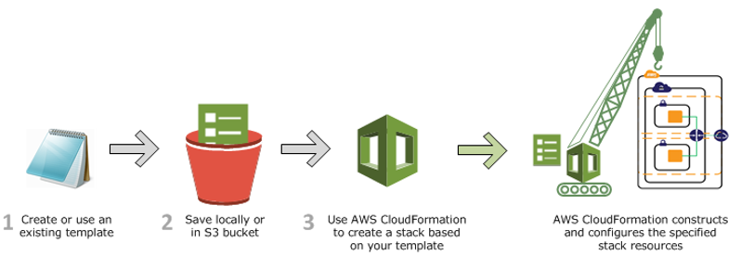
CloudFormation Process

Slide 27
To The Terminal!
3. Show Advanced YAML CloudFormation …. Run in AWS console

Slide 28
AWS Pricing
$0.0138 per Hour
Demand…. Reserved…. Spot
FREE! (mostly)
$0.12 per GB-month
$0.072 per provisioned IOPS-month
FREE!
$0.026 per GB
$0.0044 per 10,000 GET requests
$0.02 per GB data to another region
$0.024 per Hour

Slide 29

AWS Downsides
Cloud Learning Curve
Terminology…. Processes…. Pricing
Performance (and Price)
Esp. if on-premises I.T. resources heavily-utilized
Too Much Power for AWS?
Critical Mass of Users Stressing the AWS Infrastructure
Amazon Retail has muscled out 3rd party sellers
Multi-Cloud strategy as the solution?

Slide 30

Possible Next Steps
Security (esp. AWS IAM)
AWS CloudWatch Monitoring and Elasticity
DNS …. Elastic Load Balancing …. Elastic IP’s
Private Subnets and NAT Gateways

Slide 31
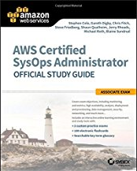
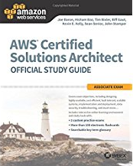
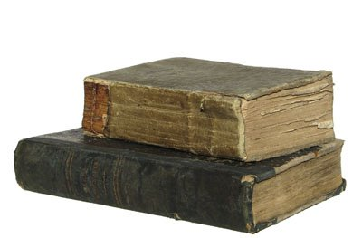
Resources
https://acloud.guru/learn/aws-certified-sysops-administrator-associate
https://app.pluralsight.com/library/courses/aws-vpc-operations/table-of-contents
https://www.packtpub.com/virtualization-and-cloud/aws-networking-cookbook
https://leanpub.com/aws-cloudformation

Slide 32

Thanks!

Slide 33
1
1
1
Infrastructure as Code:
2
2
2
3
3
3
JANUARY 10, 2018
No. 28

Slide 34
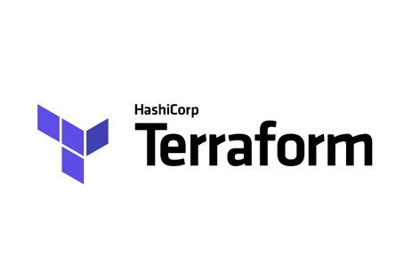
How CloudFormation Fits…
Peers
xxxxx
CI/CD Chain
CFT vs. Packer vs. Salt/Docker vs. Code/Data

Slide 35
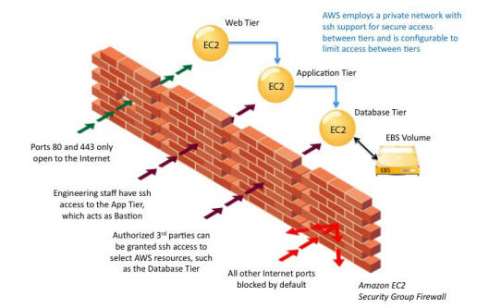
VPC Concepts (Security Groups) (???)
Router & Route Table
Geographic zones for the AWS cloud (e.g. US-East…. Canada…. Singapore)
Network ACL
Data centers within a region…. Multiple AZ’s for High Availability
Security Group
Data centers within a region…. Multiple AZ’s for High Availability

Slide 36
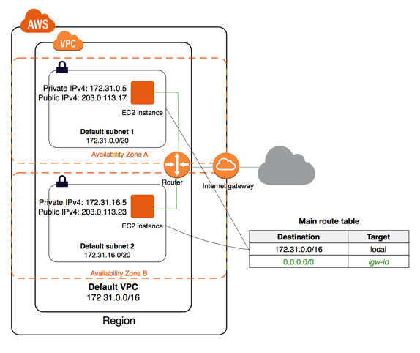
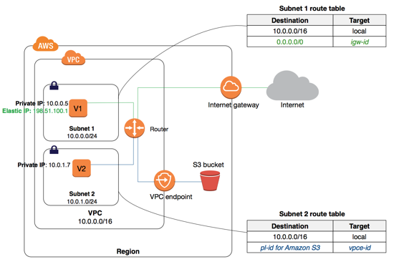

VPC Concepts (Networking)

Slide 37
VPC Concepts (Networking)
xxxx
xxxxx
xxxx
xxxxx
xxxx
xxxxx

Slide 38
Elastic Load Balancing
Launch Configuration
No need for the AWS console!
Health Checks
xxxxx
Auto Scaling Groups
xxxxx
AWS Route 53 (???)
xxxxx

Slide 39
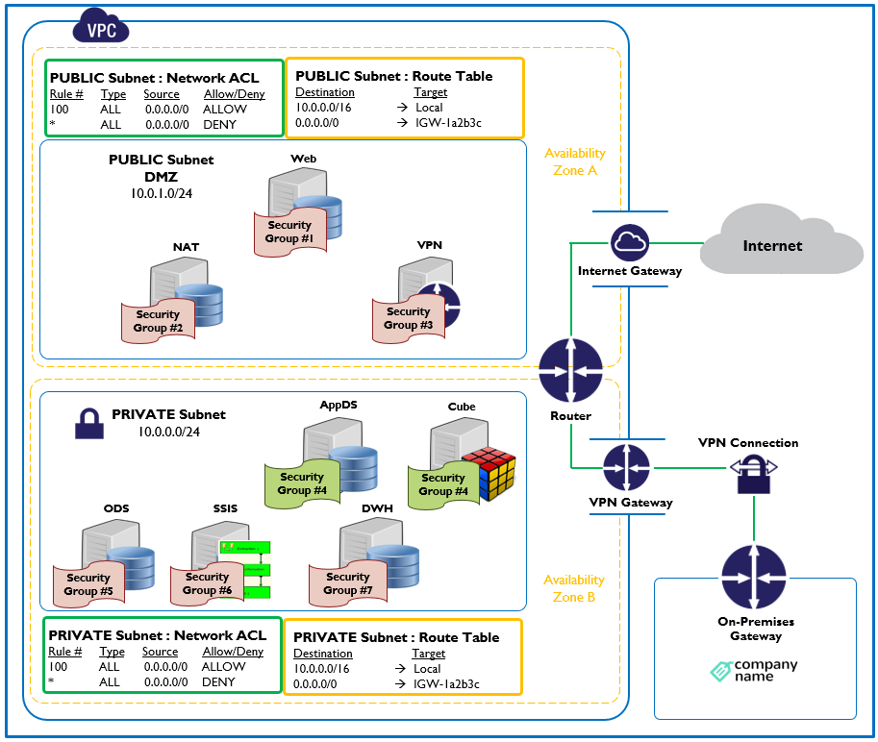
Elastic Load Balancing Diagram

